Slide 1
Multi-lineage transcriptional and cell communication signatures define pathways in individuals at-risk for developing rheumatoid arthritis that initiate and perpetuate disease
Cong
202502

Slide 2
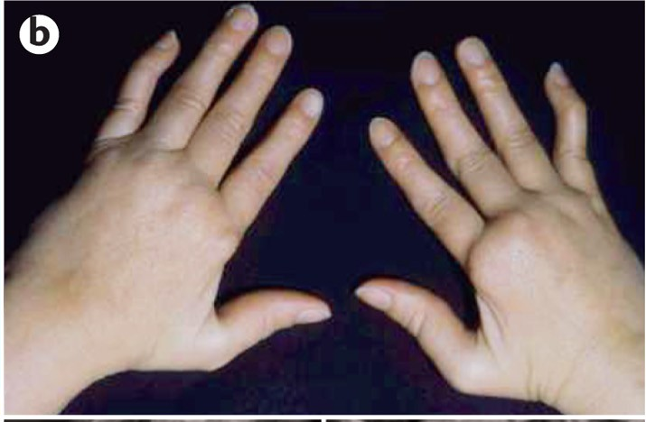

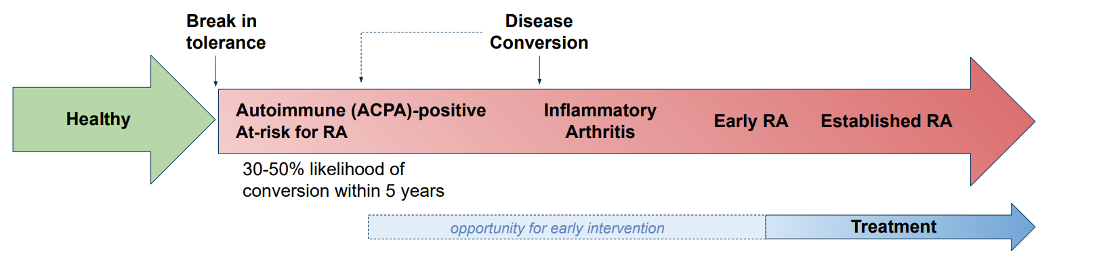
Defining RA pathogenic mechanisms is important
RA: Rheumatoid Arthritis
350 M
with RA globally
Mucosal
inflammation
1/4
adults with RA in US
Chronic joint swelling
Nature Rev Rheumatol 2018;14:542–557
N Engl J Med 2023;388:529-542.
Notes:
Rheumatoid arthritis (RA) is an autoimmune disease in which the body’s immune system attacks its own tissues, particularly joints. It causes chronic joint swelling and pain.
(click)RA is a very prevalent disease. More than 350 million people have RA globally by 2021. And in the US, 1 in 4 adults has RA.
RA is a disease that goes through several stages before definitively diagnosed. Current model suggests that RA begins with mucosal inflammation and break in self-tolerance, progresses from preclinical RA to inflammatory Arthritis, Early RA and finally to be established, destructive disease. Seropositive RA is marked by the elevated levels of autoantibody including APCAs. For At-risk individuals, there’re 30-50% likelihood of conversion within 5 years. During phase from preRA to early RA, there’re a lot of opportunities to prevent the disease progression.

Slide 3
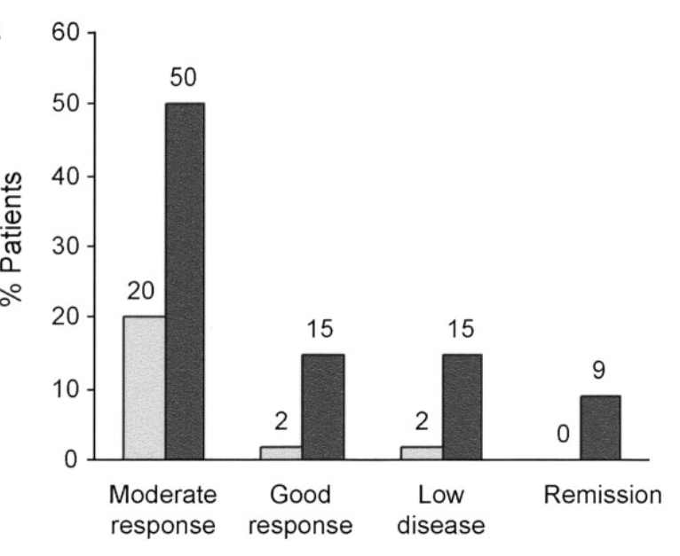
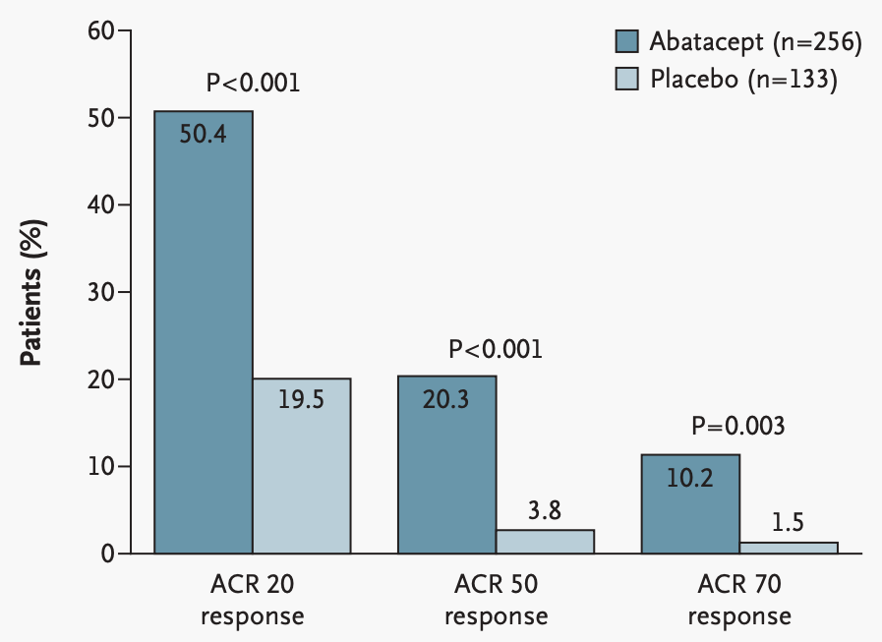
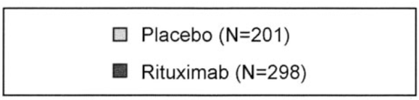
RA has diverse pathogenic mechanisms
*ACR 70: 70% improvement
REFLEX study:
Response to rituximab in TNF-IR
B cell-depleted therapy
ATTAIN study:
Response to abatacept in TNF-IR
T cell activation prevention therapy
Responses to the same targeted therapy are highly variable
Lack of improvement with one mechanism does not preclude response to another
*IR: inadequate response
Arthritis Rheum. 2006;54:2793
N Engl J Med 2005; 353:1114
Notes:
Recently, targeted therapies were developed to block particular cytokines or cell types, which have remarkedly improved clinical outcomes. However, the responses to the same targeted therapy are not uniform. Left plot shows the responses of ~300 patients to rituximab, a B cell-depleted therapy. Only half have the moderate response. A quarter of them have low response or remission. And the same for abatacept, which works by preventing T cell activation. Patients have different degree of responses. Note the patients in the two studies were those having inadequate response to TNF-a inhibitors. It suggests that lack of improvement with one drug does not preclude response to another.
We proposed that diverse pathogenic mechanisms is underlying a common clinical phenotype of RA, which complicates clinical efforts because no single agent is universally effective.
ACR score is a scale that measures changes in RA symptoms. It measures swollen joint counts, tender joint counts, physician’s global assessment of disease activity, patient’s global assessment of disease activity, patient’s assessment of pain, patient’s assessment of physical function, and either the CRP level of the ESR

Slide 4

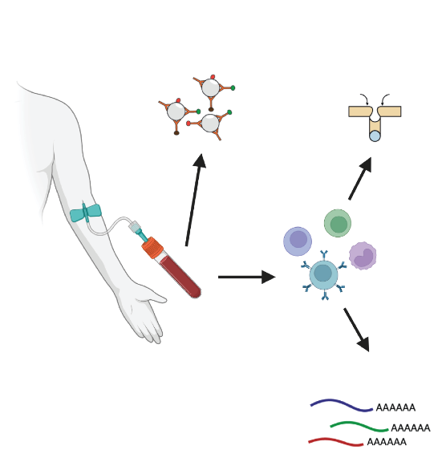



ALTRA study: define pathogenic mechanisms in RA
scATAC-seq:
~1M PBMCs
(n=35)
Healthy
(n=26)
At-Risk
(n=6)
ERA
B cell,
T cell,
NK cell,
Monocytes,
…
In total n = 67
Age and sex matched
scRNA-seq:
~1M PBMCs
Notes:
To test the hypothesis, we identified 26 ACPA-positive at-risk individuals, 6 patients with early RA and 35 matched controls. We measured single cell chromatin accessibility and transcriptomic profiles from their peripheral blood mononuclear cells. This study is as part of the ALTRA study, which is a joint effort between the Allen Institute for Immunology, the University of California-San Diego, the University of Colorado, and the Benaroya Research Institute.
This study is as part of the ALTRA study, which is the collaboration project between the Allen Institute for Immunology, the University of California-San Diego, the University of Colorado, and the Benaroya Re- search Institute.
The goal of this study is to identify novel immune features and define pathogenic mechanisms that lead to clinical RA
This study included three cohorts: 35 healthy individuals, 26 At-Risk individuals, and 6 early RA, in total 67 individuals and their age and sex are roughly matched.
Around 1M PBMCs (peripheral blood mononuclear cells) measured by scRNA-seq and scATAC-seq respectively.
Matched age: 54 (HC), 49(ERA), 59(At-Risk)
Matched sex: 82% (HC), 83% (ERA), 80% (At-Risk)

Slide 5
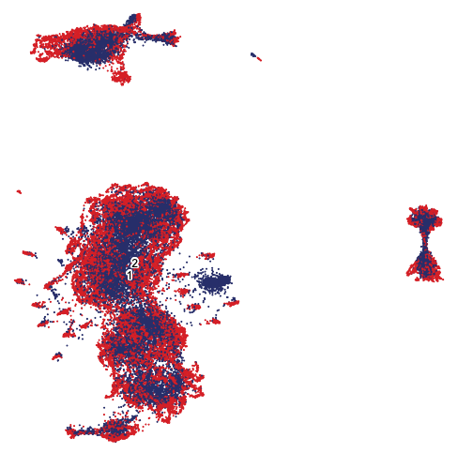
Taiji: Integrating scRNA-seq and scATAC-seq to identify critical transcription factors
Co-embed based
on cell state
2. Aggregate cells
3. Predict key TFs: Open Chromatin AND Gene Expression
cell
gene count
TF
2
0
1
gene
1
3
0
1
2
0
2
0
1
RNA
3
0
4
ATAC
2
4
5
3
Pseudo-bulk cluster
PageRank score
Nature Communications 2022;13.1: 6221
Notes:
For each sample, matched RNA and ATAC were co-embedded into shared space and into different clusters
And cells in each cluster were aggregated in terms of gene counts and open chromatin regions. We call it pseudo-bulk cluster.
Then we used Taiji, which is a method to integrate RNA seq and ATAC seq to identify critical transcription factors. It worked by constructing a regulatory network and then accessing TF importance with PageRank scores. A PageRank score tells us how important a TF is in the whole network. A TF needs to have both open chromatin regions and gene expression of its regulatees to have high PageRank scores. Just accessing to the open chromatin is not enough.
Each pseudo-bulk cluster would have its own set of PageRanks, so that we can perform cross-sectional analysis to identify important TFs in At-risk or ERAs

Slide 6
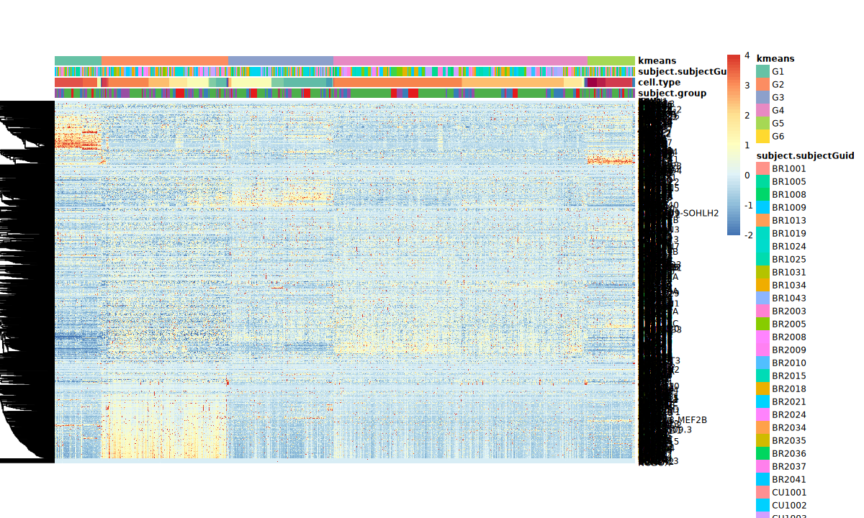
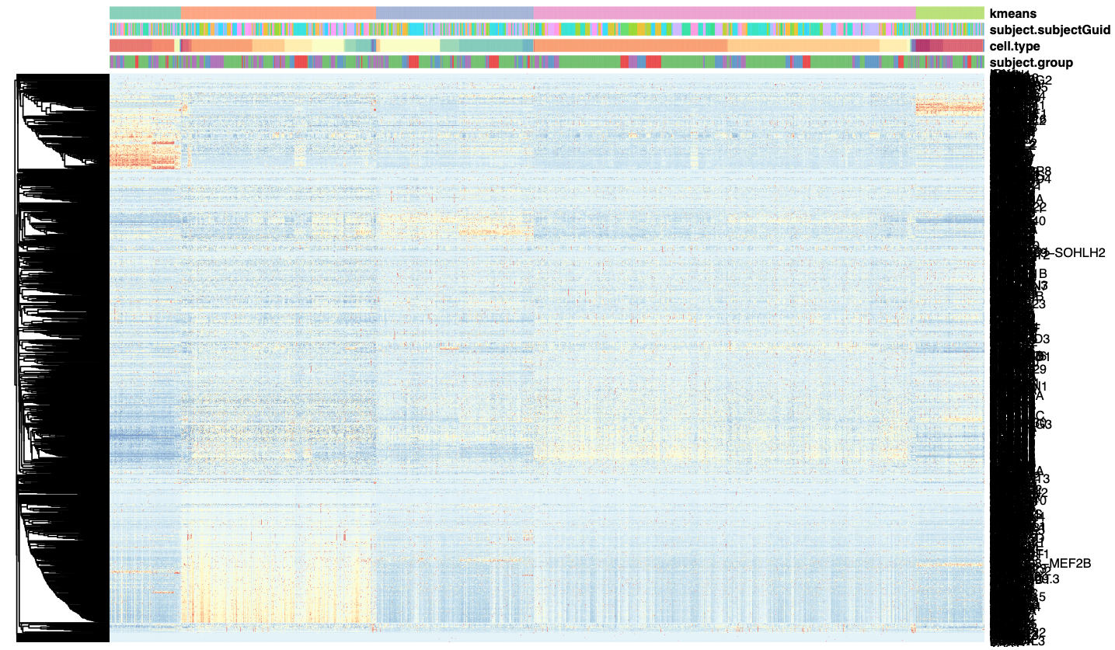

Unsupervised clustering shows distinctive TF profiles
Normalized PageRank score
G1
G2
G3
G4
G5
SPIB
4
KLF4
EOMES
TBX21
2
0
LEF1
Signature TF group
TCF7
-2
ZNF304
SP7
GLIS1
Cluster 1
Cluster 2
Notes:
Based on the PageRank scores, we performed unsupervised clustering. And the pseudo-bulk clusters were divided into 5 groups (G1-G5)
Each row is one TF while each column is one pseudo-bulk cluster. Each cell here is one PageRank score with red representing high scores.
Each group shows different patterns of TF activity. For example, a bunch of TFs show exclusively high scores in G2. We call it signature TF group, we’ll explain we’re interested in them in the next few slides
We also found there’s no segregation of At-Risk and ERA in terms of PageRank profile, so we combine them in the following analysis

Slide 7
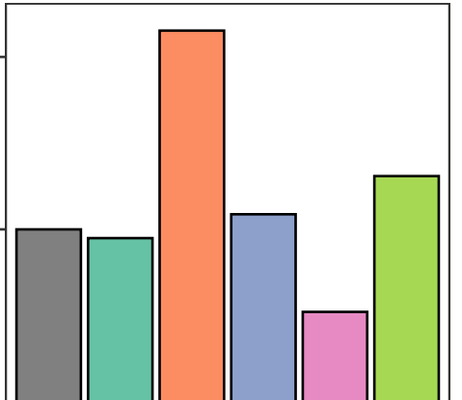
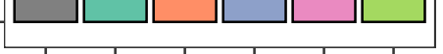
Group G2 is enriched in At-Risk/ERA
****
1.5
G2: 58% higher in non-HC
G4: 24% higher in HC
1
Adjusted non-HC/HC ratio
***
0.5
0
All
G1
G2
G3
G4
G5
Chi-squared test, ***p<0.001, ****p<0.0001
Notes:
G2 is a special group because it’s significantly enriched in At-Risk/ERA replicates compared to HC. This plot shows adjusted ratio between non-HC and HC. G2 has 54% higher in At-Risk/ERA, which is a significant enrichment. On the other hand, G4 is significantly enriched in HC samples, G5 shows the trend of non-HC enrichment as well.

Slide 8
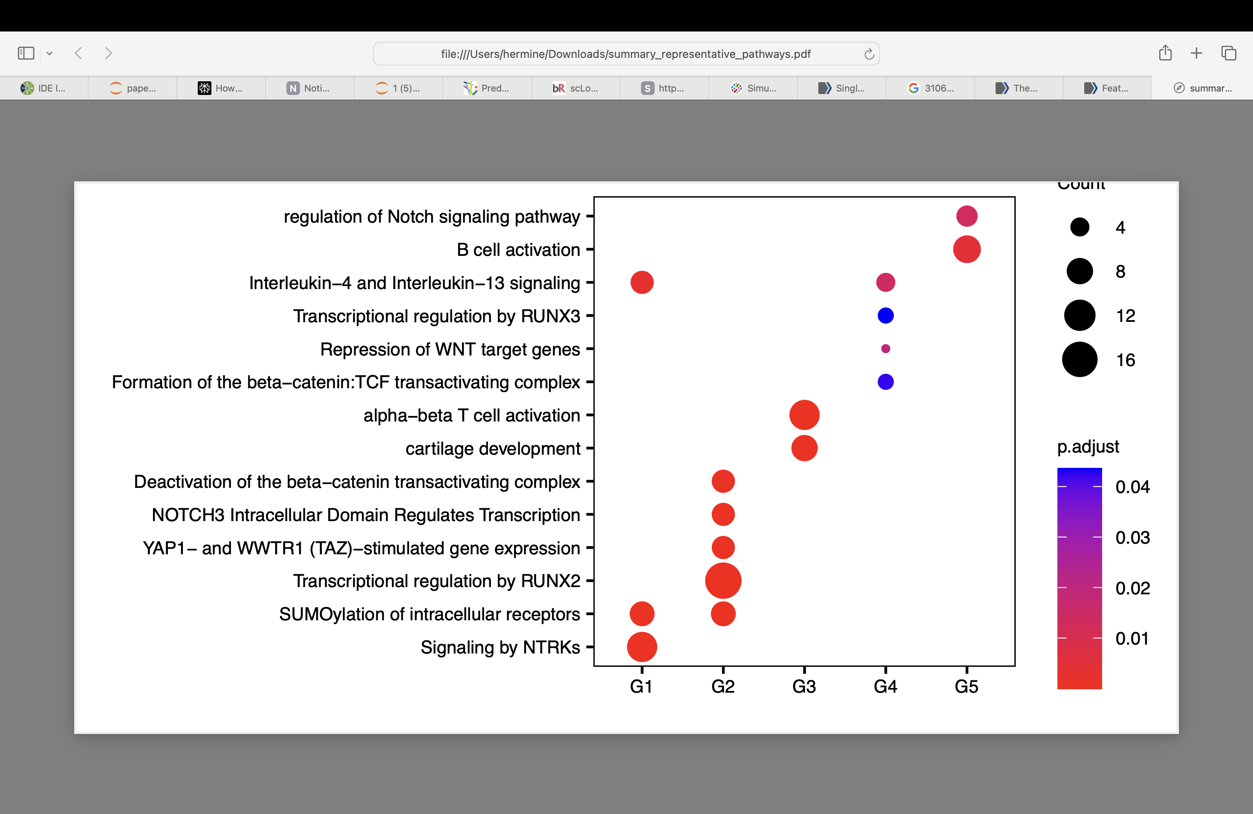
Group G2 enriched in SUMO/RUNX2/YAP1/WNT/NOTCH3 pathways
Regulation of Notch signaling pathway
B cell activation
Interleukin-4 and Interleukin-13 signaling
Transcriptional regulation by RUNX3
Repression of WNT target genes
Formation of the beta-catenin: TCF transactivating complex
Alpha-beta T cell activation
Cartilage development
Deactivation of the beta-catenin transactivating complex
NOTCH3 Intracellular Domain Regulates Transcription
YAP1- and WWTR1 (TAZ)-stimulated gene expression
Transcriptional regulation by RUNX2
SUMOylation of intracellular receptors
Signaling by NTRKs
Count
4
8
12
16
p.adjust
0.04
0.03
0.02
0.01
Signature pathways
G1
G2
G3
G4
G5
Notes:
G2-specific TFs are enriched in a lot of Reactome pathways, for example, SUMOylation, RUNX2, YAP1, NOTCH3 and wnt pathways, and all of them are very well-known in RA initiation and progression. Other groups display importance in other pathways, but it’s fewer and much less significant

Slide 9
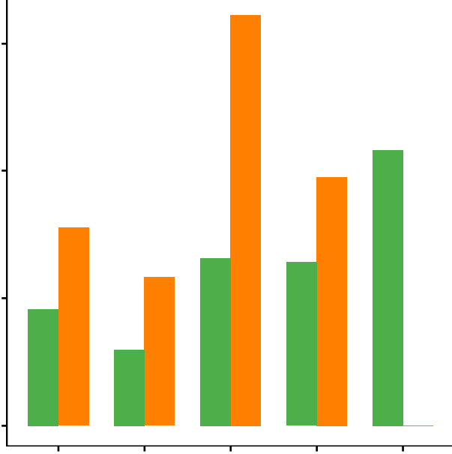
Greatest enrichment of CD4⁺ and CD8⁺ T cells in At-Risk/ERA signatures in G2
***
60
*
40
***
CON
Percentage of G2 clusters per cell type
At-Risk/ERA
***
20
*p<0.1, **p<0.05, ***p<0.01
0
CD4 T Naive
CD4 TCM
CD8 TEM
MAIT
CD8 T Naive
Notes:
Remarkably, the G2 signatures were shared by multiple lineages in individual At-Risk and ERA participants.
CD4 T naïve, CD4 TCM, and CD8 T naïve had greatest enrichment among all the cell lineages.
Of interest, MAIT cells with the TF profile were only found in HC samples
MAIT cells are innate resident T cells that can produce proinflammatory cytokines in target organs. It’s possible that MAIT cells are protective
It has been found that MAIT cells in patients with RA have a significantly reduced frequency in peripheral blood while they’re enriched in synovial fluid
Fig. 3B, Adjusted ratio of G2 clusters across 5 states, green for HC G2 clusters ratio, orange for non-HC G2 clusters ratio
We have 56 MAIT replicates in total, 43 is HC, 9 pre-RA, 4 ERA.

Slide 10
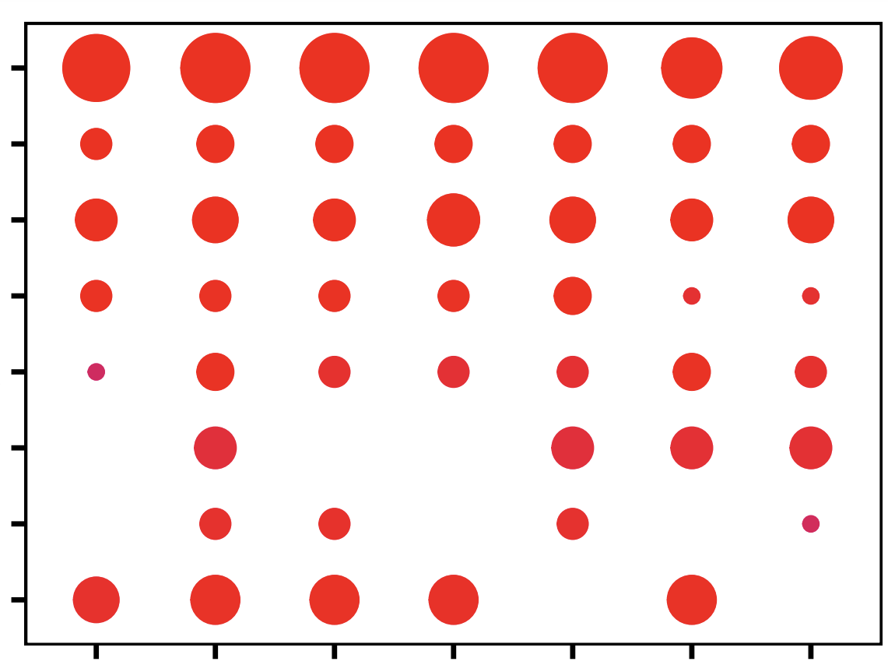
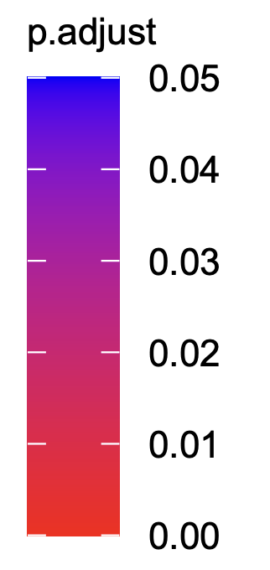
Signature pathways are shared in multiple cell types
Signature pathways
Transcriptional regulation by RUNX2
YAP1- and WWTR1 (TAZ)-stimulated gene expression
SUMOylation of intracellular receptors
NOTCH3 Intracellular Domain Regulates Transcription
Deactivation of the beta-catenin transactivating complex
Transcriptional regulation by RUNX3
NGF-stimulated transcription
Activation of HOX genes during differentiation
count
0.05
B cell
CD4 TCM
CD8 TEM
NK cell
p.adjust
CD4 T Naive
CD8 T Naive
Monocytes
0.02
4
8
12
16
0
Notes:
The signature pathways are also shared by different cell lineages. The color represents the significance level. Redder means more significant.
All the major cell types were enriched in this common set of At-Risk/ERA signature pathways while some individual cell types demonstrated specific enriched pathways
For example, activation of HOX genes was enriched in B cells, CD4 T cells, CD8 T Naive, and monocytes. RUNX3 regulation is more highly associated with CD8 TEM, NK, CD4 T Naive, and monocytes²³. Despite individual variations described above, the general pattern of pathways associated with pathogenesis of RA is consistent and extends across the identified cell types.

Slide 11
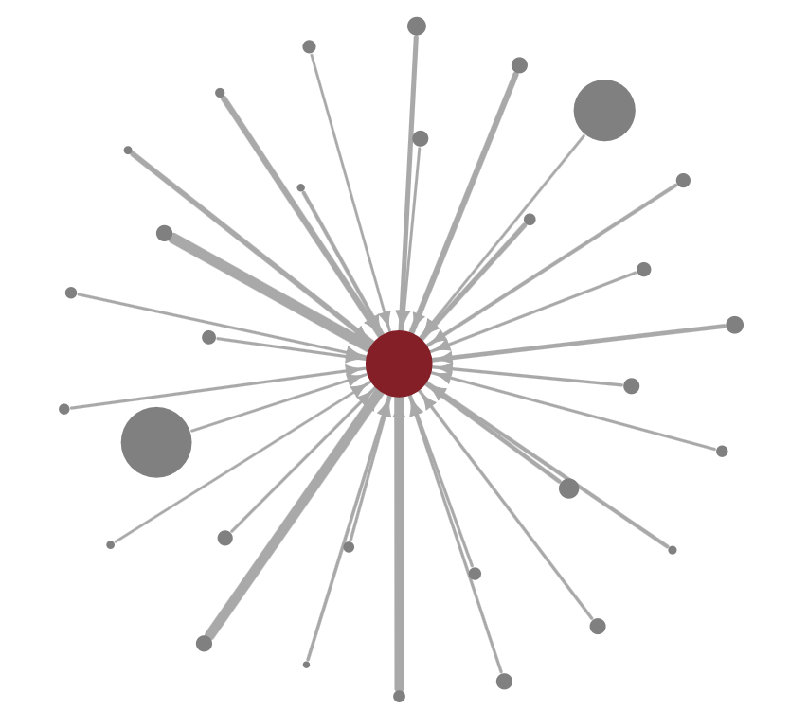
Signature TFs regulate pathogenic genes
TFAP2A
Our hypothesis
LHX8
SALL2
WT1
PRDM5
Signature pathways via epigenetic remodeling in multiple cell types
ZFY
ZNF98
ZNF662
HNF4A
RORC
ZBTB12
Monocytes
B cell
NK
CTCFL
ETV5
ZNF311
TGFB1
LBX
RA Signature TFs,
e.g. SUMOylation, RUNX2, YAP1, NOTCH3, and β-Catenin
EGR4
Pathogenic genes, e.g. TGFB1
PRDM6
AIRE
SP7
ETV1
ZNF695
ZNF704
KLF15
ZSCAN1
ERG
CD4 T Naive
CD8 T Naive
GLIS3
CD4 TCM
CD8 TEM
EGR2
ALX3
PRRX2
Circle size: PageRank
Edge width: regulatory strength
KLF1
Notes:
So far we showed the biological relevance of signature TFs. Next I checked the regulatory relationship between signature TFs and its downstream genes and many pathogenic genes were found. We used TGF-b1 as an example here, since it’s a well-known player in RA pathogenesis.
I showed the top 30 regulators here based on the regulatory strength. It turns out some well-known RA-related TFs popped out, like TFAP2A, KLF1, and RORC
Based on the above results, we proposed the hypothesis: under the influence of risk factors, epigenetic remodeling took place in multiple cell types. These RA signature TFs are involved in signature pathways. The signature TFs drive a characteristic set of pro-inflammatory genes like TGFB1 and contributes to the onset and perpetuation of RA.

Slide 12
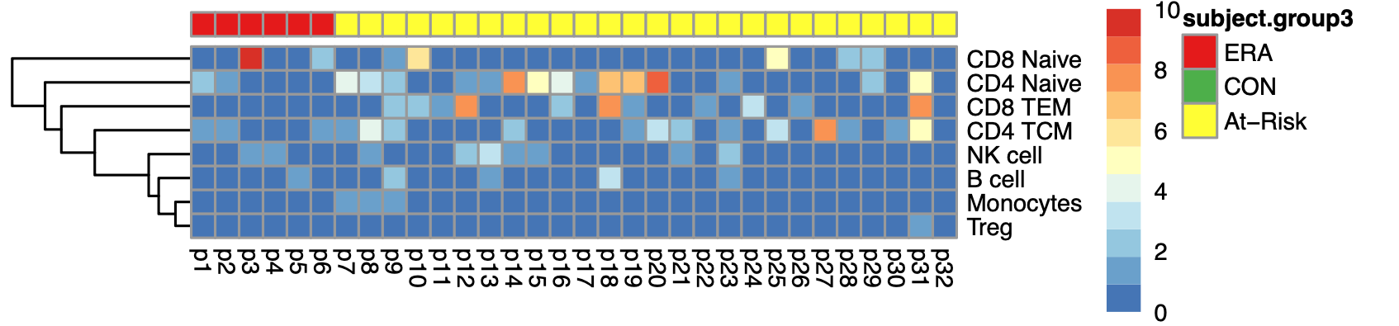
“RA signature” is shared across patients and cell lineages in Group G2
ERA
At-Risk
CD8 T Naive
CD4 T Naive
# of G2 clusters
CD8 TEM
CD4 TCM
>=10
NK cell
B cell
5
Monocytes
Treg
0
p10
p11
p12
p13
p14
p15
p16
p17
p18
p19
p20
p21
p22
p23
p24
p25
p26
p27
p28
p29
p30
p31
p1
p2
p3
p4
p5
p6
p7
p8
p9
p32
This could possibly explain the diverse clinical responses to the same targeted therapies.
Notes:
Last but not least, the RA signature is actually shared across patients and cell lineages. This is the heatmap of participants in G2 across cell lineages. The horizontal axis shows the individual participants, and the vertical axis shows cel lineage. The brighter color means the patient has greater number of co-embedded clusters in specific cell type.
Twenty-five out of 26 At-Risk and all 6 ERA participants had the signature in at least one cluster and in at least one of the key cell types. The one negative At-Risk individual could have had a similar pattern in a rare cell type beyond the resolution of this analysis.
Some patients showed the pattern in more than one cell lineage. For example, participant 10 has multiple cell lineages in G2, with only NK and Treg as exceptions. And participant 13 only showed the pattern in CD8TEM
Among all the involved cell lineages, the signature is mostly enriched in certain T cell types
One of the tricky part of RA pathogenesis is that although different patients display the same phenotype, they may have different pathogenic pathways and cell lineages involved. That’s why the clinical responses are diverse to the same targeted therapies.
Here, we observed that the cell lineages with these TFs and pathways varied between individual participants, which could explain the diversity of clinical responses. For example, participant 26 has the RA signature in the T cells, may suggesting T cells-targeted therapy is most beneficial for early prevention. On the other hand, participant 22 shows the signature in B cells. So B cell depleted therapy may be contributing to its prevention.
One last remark, the signature is found in both ERA and At-Risk, suggesting some common mechanism during RA progression. And this could be helpful guiding the development of prevention strategy
Some HCs also displayed these clusters although the number of clusters was significantly less than at-risk/ERA, particularly for certain T cell subsets.

Slide 13
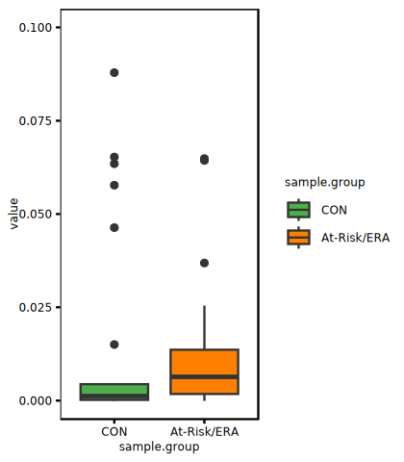
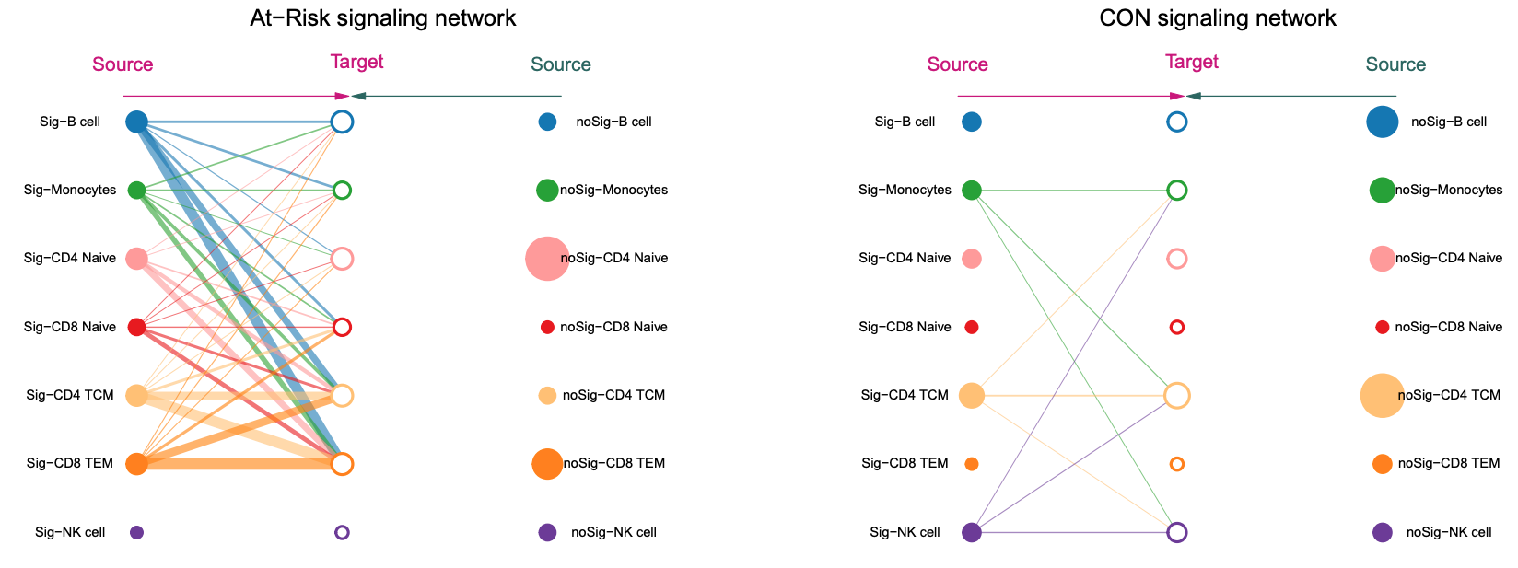
Increased cellular communications in At-Risk/ERA
0.1
participant 53
participant 9
**
Source
Target
Source
Target
B cell
Interaction strength
0.05
Monocytes
CD4 T Naive
CD8 T Naive
0
CD4 TCM
CON
At-Risk/ERA
CD8 TEM
NK cell
Wilcoxon rank-sum test, **p<0.05
Each dot is one participant
Edge weight represents interaction strength
Notes:
After demonstrating individualized patterns of signature cluster cell types in At-Risk/ERA, we then investigated how the signature cells communicate to determine how inflammation signals are transmitted. Cell-cell communications (CCC) were analyzed by correlating expression levels of ligands such as cytokines in the source cells with their corresponding receptor expressions in the receiver cells for each individual using CellChat²⁴. To compare At-Risk/ERA and CON groups, we first aggregated CCC between the same signature cells across all the ligand-receptor pairs and all the individuals within the group. We observed distinct CCC patterns: At-Risk/ERA participants displayed significantly more interactions within signature clusters than controls, particularly between T cells and NK cells.
The total communication strength in At-Risk/ERA was significantly higher than control group (p-value=0.04 using Wilcoxon rank-sum test). As a representative example, participant 53 from control group and participant 9 from At-Risk/ERA group had the most diverse cell type distribution in signature clusters (Supplementary Fig. S3A; Fig. 4C), providing an overview of almost all the cell types.

Slide 14
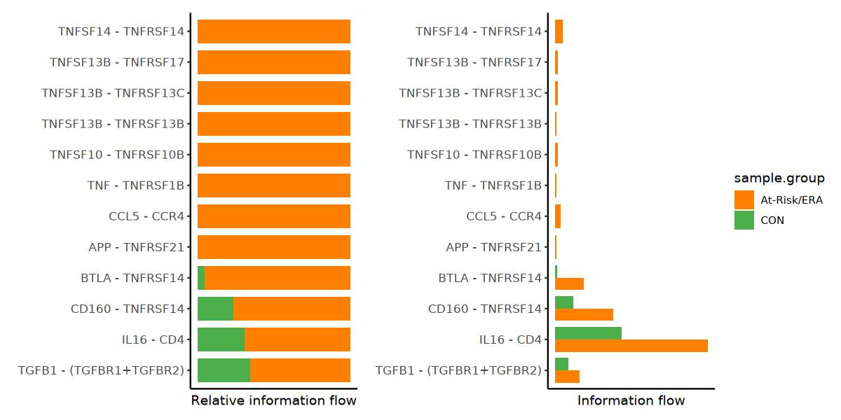
Increased ligand-receptor pairs in At-Risk/ERA
TNFSF14 - TNFRSF14
TNFSF13B - TNFRSF17
CON
TNFSF13B - TNFRSF13C
At-Risk/ERA
TNFSF13B - TNFRSF13B
TNFSF10 - TNFRSF10B
TNF - TNFRSF1B
CCL5 - CCR4
APP - TNFRSF21
BTLA - TNFRSF14
CD160 - TNFRSF14
IL16 - CD4
TGF-β1 - (TGFBR1+TGFBR2)
Relative information flow
Absolute information flow
Notes:
Out of the identified significant ligand-receptor pairs in each participant, twelve ligand-receptor pairs were related to this pathogenic gene set. We ranked the important pathways based on the difference in total information flow within signature clusters when comparing At-Risk/ERA to control samples. The IL16 - CD4, CD160 - TNFRSF14, TGF-β1 – (TGFBR1+TGFBR2), and BTLA - TNFRSF14 were the most prominent ligand-receptor pairs enriched in At-Risk/ERA considering both the difference and absolute information flow values (Fig. 4D).

Slide 15
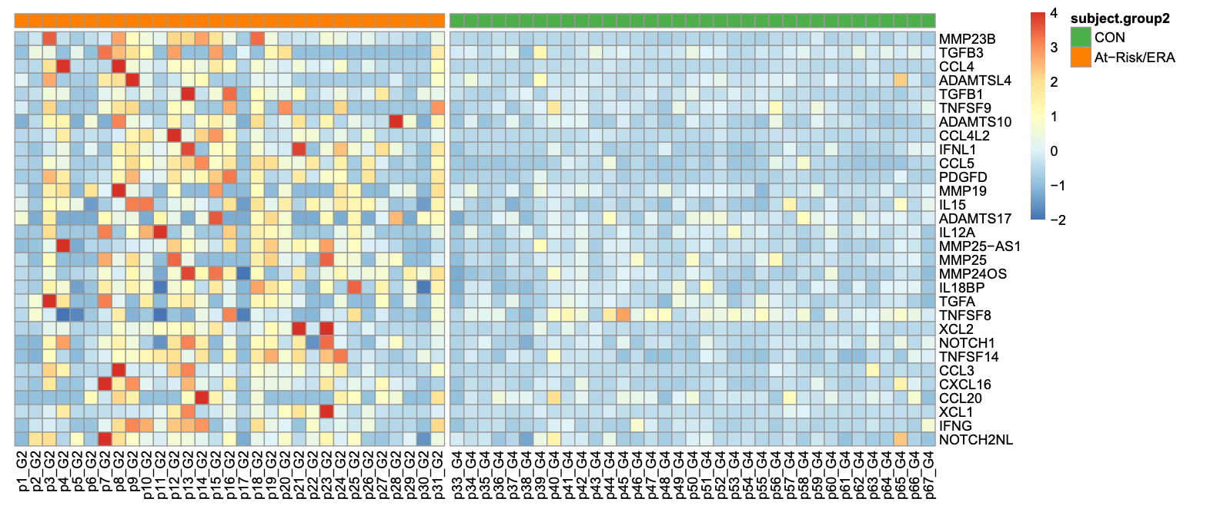
Elevated activity of pathogenic genes
At-Risk/ERA
CON
participant
MMP23B
TGFB3
CCL4
ADAMTSL4
TGFB1
TNFSF9
ADAMTS10
CCL4L2
IFNL1
CCL5
PDGFD
MMP19
IL15
ADAMTS17
IL12A
MMP25-AS1
MMP25
MMP24OS
IL18BP
TGFA
TNFSF8
XCL2
NOTCH1
TNFSF14
CCL3
CXCL16
CCL20
XCL1
IFNG
NOTCH2NL
4
Normalized
gene expression
4
2
2
Normalized gene expression
0
0
-2
-2
Notes:
Not just TGFB1, other pathogenic genes also exhibited higher activity in At-Risk/ERA patients than controls.

Slide 16
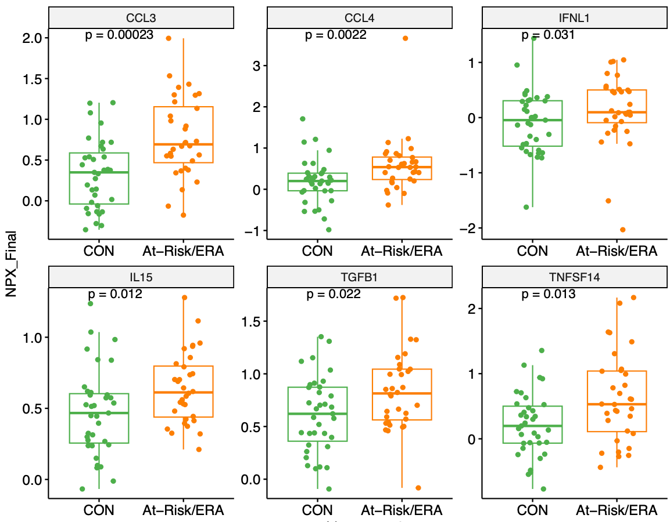
Elevated protein expression in At-Risk/ERA
CCL3
CCL4
IFN-λ1
3
1
1.5
1.0
2
0
0.5
1
0
-1
0.0
-1
-2
CON
Normalized protein expression
At-Risk/ERA
IL-15
TGF-β1
TNFSF14
1.5
2
1.0
1.0
1
0.5
0.5
0
0.0
0.0

Slide 17
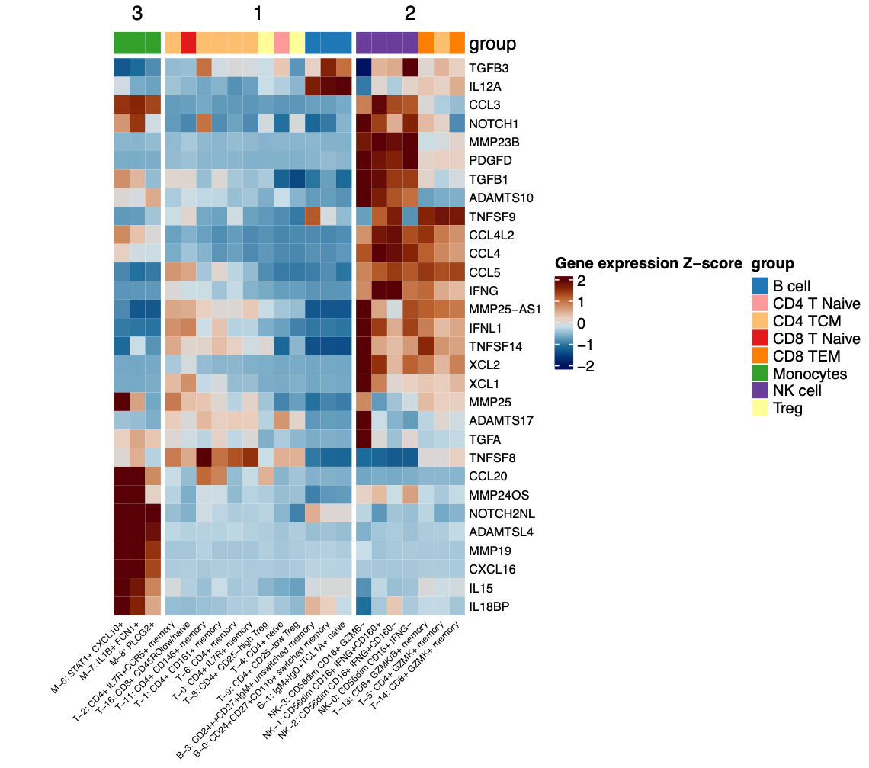
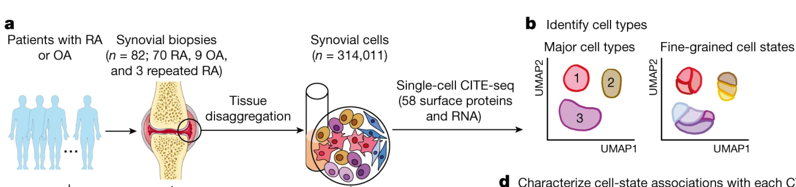
Top PBMC mediators' expression in synovial tissues
Top PBMC mediators’ gene expression in synovial tissues
Accelerating Medicine Partnerships (AMP) synovial scRNA-seq
Notes:
We then evaluated the Accelerating Medicine Partnerships (AMP) synovial scRNA-seq data to determine if the RA gene expression signature observed in peripheral blood was confirmed in the inflamed tissue and whether a diversity of cell types was also present¹¹. The top mediators were also found in synovial cells and, more strikingly, there was broad diversity of the cell types within the synovial tissues that expressed them.

Slide 18
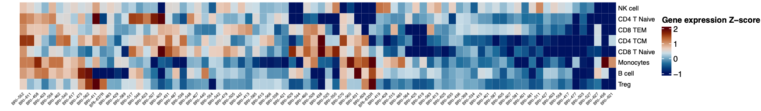
Individualized signature patterns in synovial tissues
82 Established RA participants
NK cell
CD4 T Naive
CD8 TEM
CD4 TCM
CD8 T Naive
Monocytes
B cell
Treg
BRI-552
BRI-456
This could possibly explain the diverse clinical responses to the same targeted therapies.
Notes:
As with PBMCs, distribution of cell types was highly variable among RA samples. In some cases, one dominant cell type was identified for an individual participant, such as monocytes in sample BRI-456, while in others there were multiple cell types, such as instance, BRI-552, displayed expression across all the cell types.
This heterogeneity suggests that each RA patient, like pre-RA and early RA PBMCs, have this molecular signature.

Slide 19

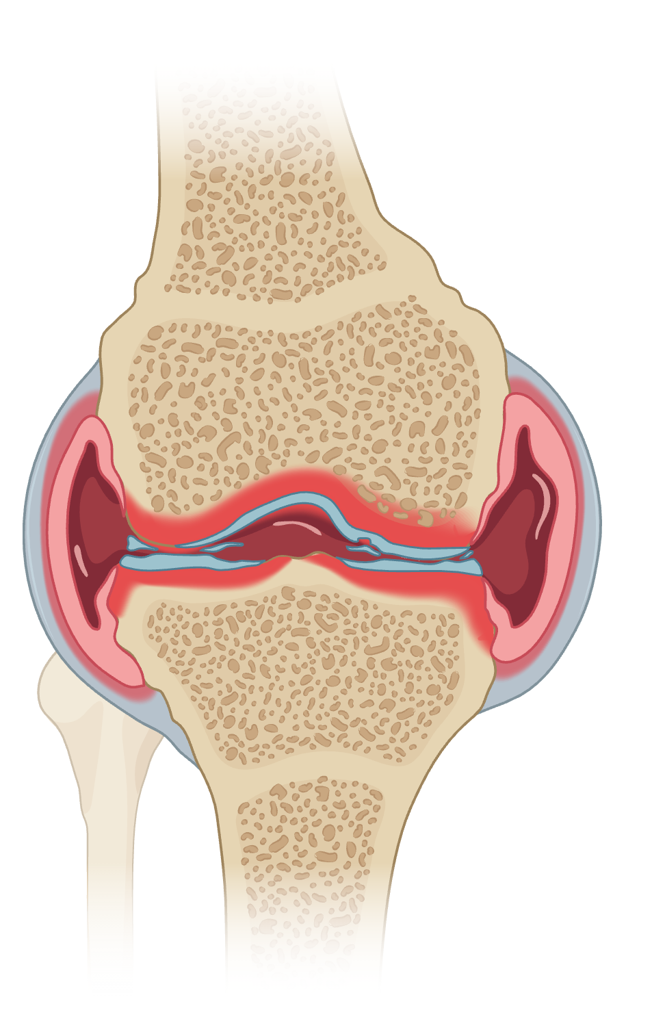



Outlook
Diverse cell types and mechanisms lead to common phenotype of RA
Hypothesis: each patient has its own pattern of cell types that’s responsible for transition
Validation plan:
Longitudinal study on the signature presence
Association btw signature and conversion
Association btw signature and clinical responses
Rituximab
Monocytes
NK
B cell
TNF inhibitor
CD8 TEM
Abatacept
CD4 T Naive
CD8 T Naive
CD4 TCM
Abatacept/TNF inhibitor
Notes:
It provides additional evidence to our proposal: each patient has its own pattern of cell types that’s responsible for transition. It’s agnostic about which cell provides the signal as long as the receiving pathogenic cell has access to them.
We believe these individualized patterns can account for the highly variable clinical response. For example, patients with signature in B cells will probably respond better to rituximab compared with patients without B cell signature. If the signature is present in CD8 T cells, especially CD8+ Granzyme B/K+ T cells, we would predict a good clinical response to a TNF inhibitor. Alternatively, naïve CD4 T cells signature would predict a response to an agent like abatacept which targets naïve T cell co-stimulation. That’s what we want to test next.
Similarly, we plan to determine if individual or combinations of inflammatory mediators are associated with subsequent response to therapy.

Slide 20
Key take-aways
Distinctive TF signature and genes enriched in early RA and at-risk individuals
TFs involved in pathogenic pathways that have been identified in RA
Cell lineages with signatures varied between individuals, possibly explaining diversity of clinical responses to targeted therapeutics
Notes:
In conclusion, our study defined a distinctive RA TF signature and genes enriched in At-Risk/ERA group compared to controls. These TFs involved in pathogenic pathways that have been identified in RA.
Analysis of cell-cell communication shows that the signature-bearing cells deliver shared pro-inflammatory signal to receiver cells.
Notably, signatures are present in diverse cell types from different individuals, potentially explaining the diversity of clinical responses to targeted therapeutics
Next I want to briefly mention the other two projects related to TF functions before moving on to the prediction model.

